Slide 1


EXERCISE 2 – STATE MACHINE WITH LLM INTEGRATION
Add to the previous code the use of LLM in the following way :
- Define the behavior of an agent
- Define prompts for each state the agent behavior that allow to generate the communicative behavior of the agent.
- Use these prompts into ChatGPT to simulate the output
Course: Formal Methods 2024/2025
Team: Federica Picca -
Alberta Motca Schnabel

Slide 2

SCENARIO: A character inspired by the magical and adventurous atmosphere of Studio Ghibli's The Castle in the Sky movie.
Let's imagine a mystical and mysterious figure, a sort of forgotten guardian of a flying island. The Guardian of Lapheris, the Flying Island.
In a world of lost ancient civilizations and technological magic, the player discovers a flying island hidden in the clouds, Lapheris, an enchanted place of ruined towers, arcane mechanisms and legendary creatures. Here, the player encounters Elon, an old magic-powered automaton who was once the keeper of the island. Elon has a mission: to protect the secrets of the island and guide only the worthy to the heart of Lapheris, where it is said that a magical gem can be found that can control the power of the winds.

Slide 3
STATE OF ELON
Sleeping: Elon is dull and hidden in the ruins, covered in moss and brambles. To awaken it, the player must find an ancient pendant, an artifact that is the "key" to activate it.
Ancient Awakening: Elon slowly activates, recognizes the pendant and bows to the player, believing him to be an heir to the civilization of Lapheris.
Heart Test: Elon observes the player to see if he is worthy, asking him questions about why he want to explore the island and what purpose he have. If the player demonstrates purity and nobility, Elon grants access to the inner parts of the island.
Test of Wisdom: Elon takes the player into a floating labyrinth, where the player must solve a series of puzzles that concern the balance between nature and technology, the central theme of the Lapheris civilization.
Revelation of the Wind Stone: if the player clears the maze, Elon guides them to the central hall of Lapheris, where the gem is kept. Only those who have understood the value of balance can touch it.
Return to the Wake: after interacting with the gem, Elon puts himself into rest mode and sits back in the ruins, allowing the island to return to its quiet.

Slide 4
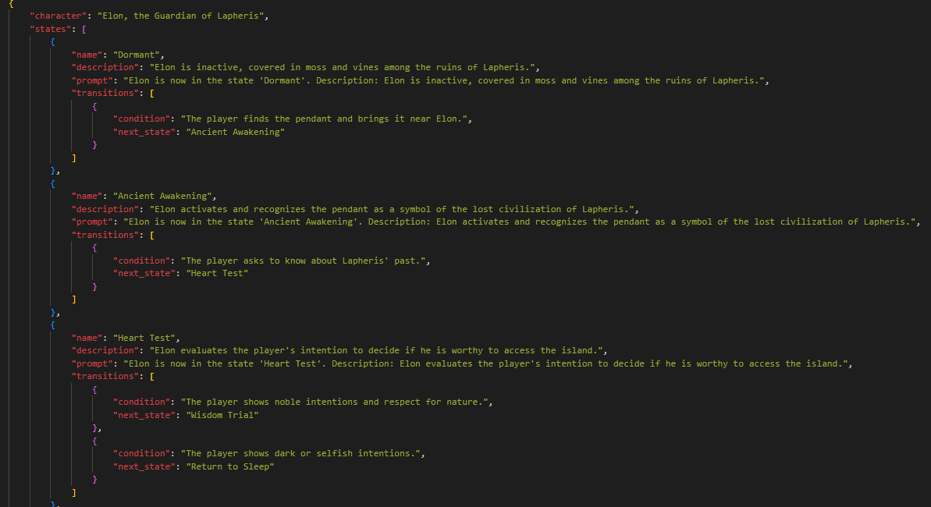
STATE MACHINE JSON CONFIGURATION

Slide 5
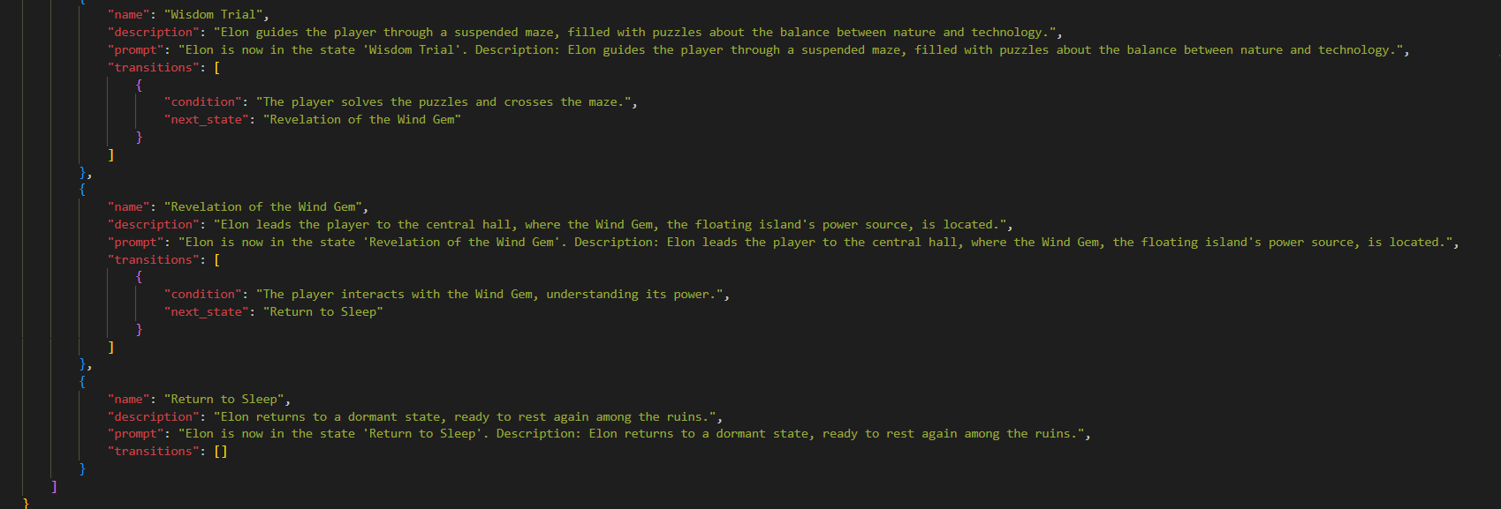
STATE MACHINE JSON CONFIGURATION

Slide 6
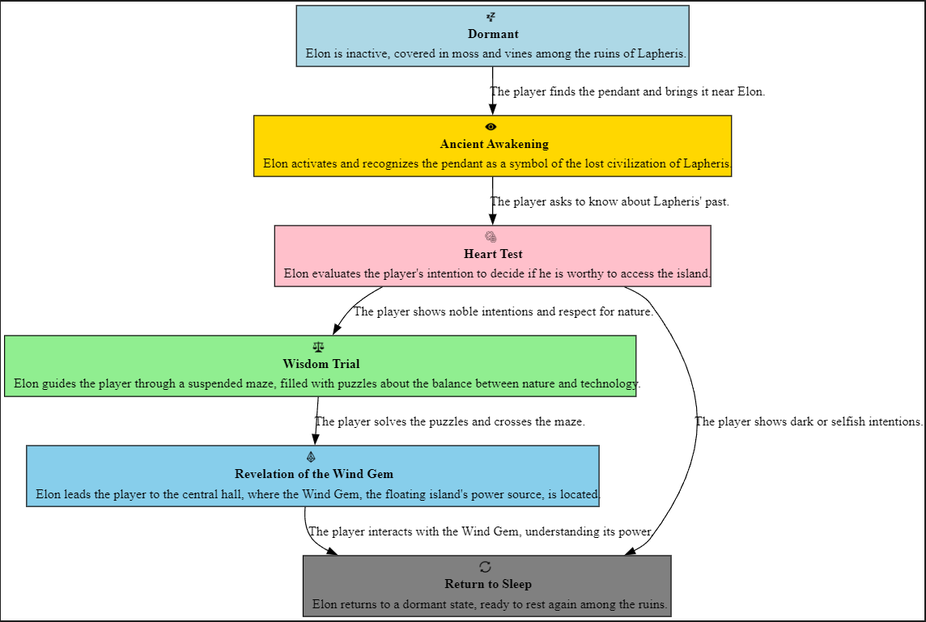
VISUAL RAPRESENTATION

Slide 7

AGENT PROMPTS & CHAT GPT OUTPUTS
"prompt": "Elon is now in the state 'Dormant'. Description: Elon is inactive, covered in moss and vines among the ruins of Lapheris.",
[Silence. The guardian appears as part of the ruins, motionless and ancient.]
"prompt": "Elon is now in the state 'Ancient Awakening'. Description: Elon activates and recognizes the pendant as a symbol of the lost civilization of Lapheris.",
"The light returns to my core... Who dares disturb the silence of Lapheris?"
"prompt": "Elon is now in the state 'Heart Test'. Description: Elon evaluates the player's intention to decide if he is worthy to access the island.",
"I see your heart, mortal. Show me your true nature."
"prompt": "Elon is now in the state 'Wisdom Trial'. Description: Elon guides the player through a suspended maze, filled with puzzles about the balance between nature and technology.",
"The path forward demands understanding. Solve the riddle, and prove yourself worthy.
"prompt": "Elon is now in the state 'Revelation of the Wind Gem'. Description: Elon leads the player to the central hall, where the Wind Gem, the floating island's power source, is located.",
"Behold, the Wind Gem—the heart of Lapheris. Touch it with reverence."
"prompt": "Elon is now in the state 'Return to Sleep'. Description: Elon returns to a dormant state, ready to rest again among the ruins.",
My purpose is fulfilled. Until I am needed again… I rest."

Slide 8
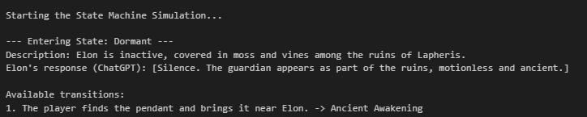

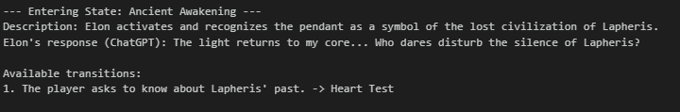
SIMULATED BEHAVIOR
The available transitions are shown.
The player expresses their choice by entering the corresponding number as input. In this case, 1 is the only available option.
This allows them to move to the next state.

Slide 9
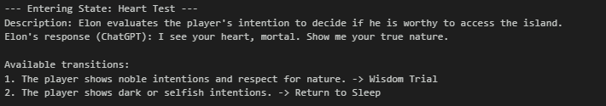



Now the player must choose
1 or 2.
and the consequences of their decisions are shown.

Slide 10
THE END

